Slide 1

Calibrating NUCOM-BOG
Jeroen Pullens
14 September - 14 December 2015 at University Freiburg
PhD supervisors: Damiano Gianelle, Matteo Sottocornola, Ger Kiely
Collaborators COST Action: Maurizio Bagnara and Florian Hartig

Slide 2
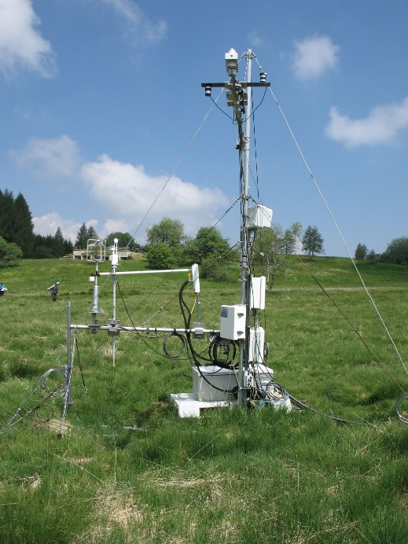
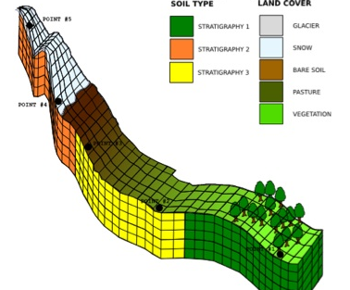
Background
Studied Biology at Wageningen University, Netherlands
PhD scholarship at Fondazione Edmund Mach, Italy
Enrolled at University College Cork, Ireland
Main focus
  Peatlands
  Greenhouse gases
  Climate change

Slide 3
Research Questions and aims
Is it possible to calibrate a model for individual sites, by changing some of the plant parameters?
  If so, do the differences in parameters have an ecological meaning or can they be explained by other factors, such as climate?
How are sites in different climates different from each other?
TG13 – Review of model parameterization methods
Notes:
These are the same as the questions asked by Profound.

Slide 4
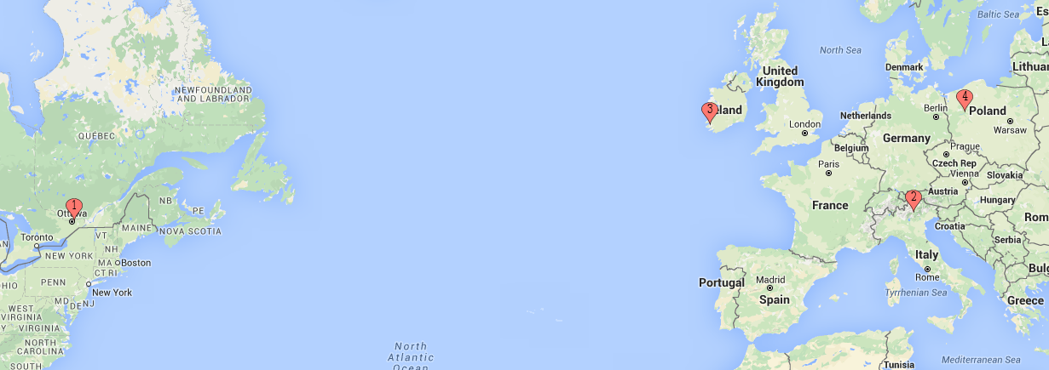
Map
4 Locations:
1) Mer Bleue (Canada)
2) Monte Bondone (Italy)
3) Glencar (Ireland)
4) Rzecin (Poland)

Slide 5
NUCOM-BOG
Nitrogen deposition
Light
graminoids
Competition
  Nitrogen
  Light
5 plant functional types
dwarf
shrubs
living
hollow
lawn
hummock
moss
Sphagna
Sphagna
Sphagna
top
stem
peat
Heijmans, M. M. P. D., D. Mauquoy, B. van Geel, and F. Berendse. 2008. Long-term effects of climate change on vegetation and carbon dynamics in peat bogs. Journal of Vegetation Science 19:307–320.
Water level
lower
root
peat

Slide 6
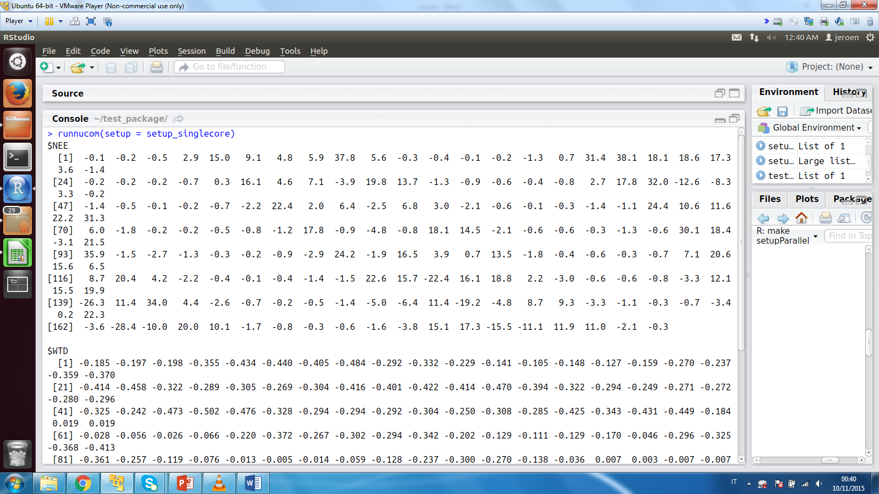
Methods
Create R package → callable with different parameters from R
  Tutorial
  Added also parallel option for speedup
  Package will become available on the COST Git hub

Slide 7
Sensitivity Analysis
Goal: To identify sensitive parameters
Morris function
26 parameters out of >200
  Growth
  Mortality
Sensitivity
Standard deviation
Mean
Morris, M. D. 1991. Factorial Sampling Plans for Preliminary Computational Experiments. Technometrics 33:161–174.

Slide 8
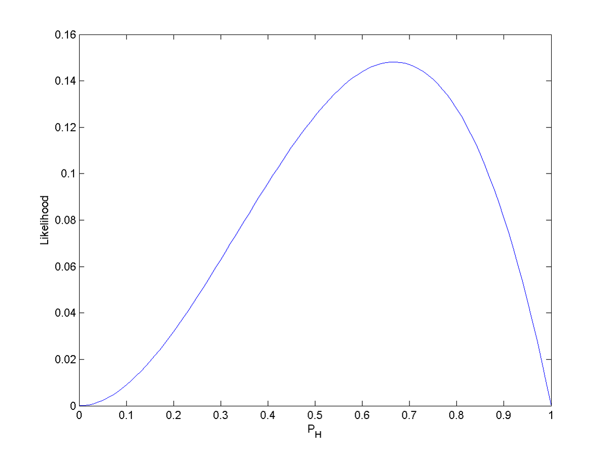
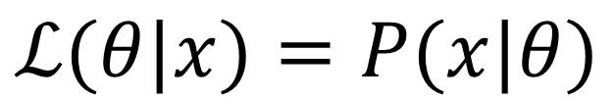
Calibration goal
Likelihood → data and model
Normal likelihood
$$ℒ(θ|x)=P(x|θ)$$
Notes:
Likelihood is the hypothetical probability that an event that has already occurred would yield a specific outcome. The concept differs from that of a probability in that a probability refers to the occurrence of future events, while a likelihood refers to past events with known outcomes.

Slide 9
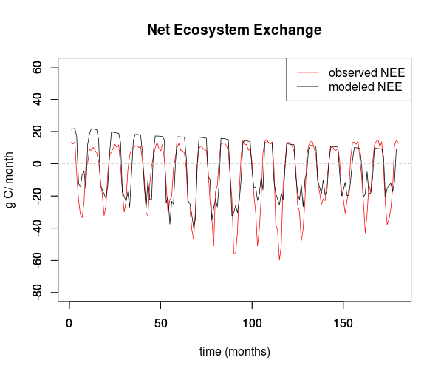
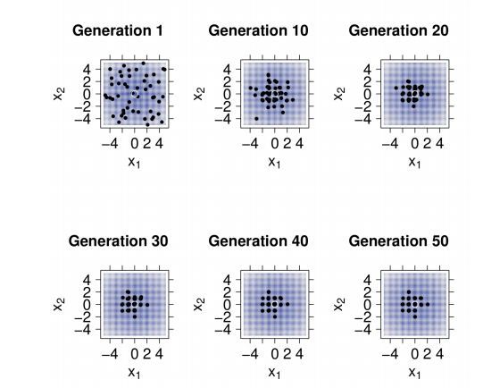
DEoptim (optimizer)
Goal: To find the optimum values for the parameters
Differential Evolution
Strength:
  Evolves to a minimum
Notes:
DEOPTIM without DECOMP parameters

Slide 10
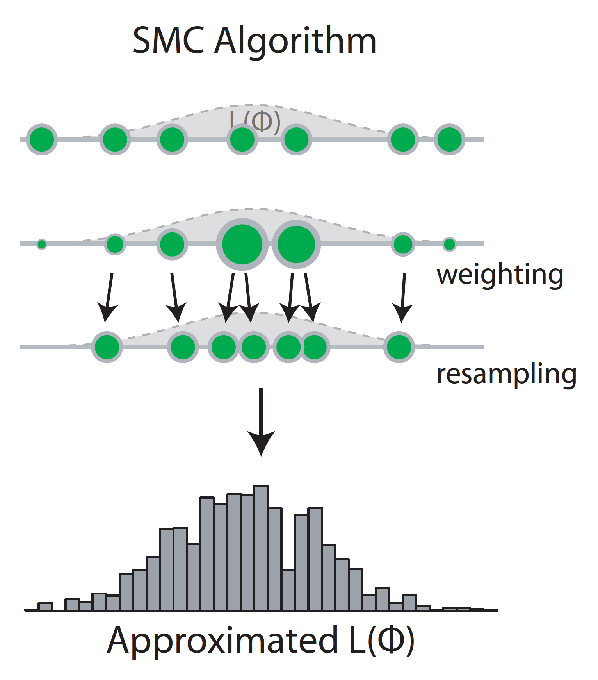
Sequential Monte Carlo
Goal: To find the optimum values for the parameters and their distribution.
Bayesian
Parallel
Weighting
Resampling
iterations
Figure from: Hartig, F., J. M. Calabrese, B. Reineking, T. Wiegand, and A. Huth. 2011. Statistical inference for stochastic simulation models - theory and application. Ecology Letters 14:816–827.
Notes:
Calibrating
Posterior distibution

Slide 11
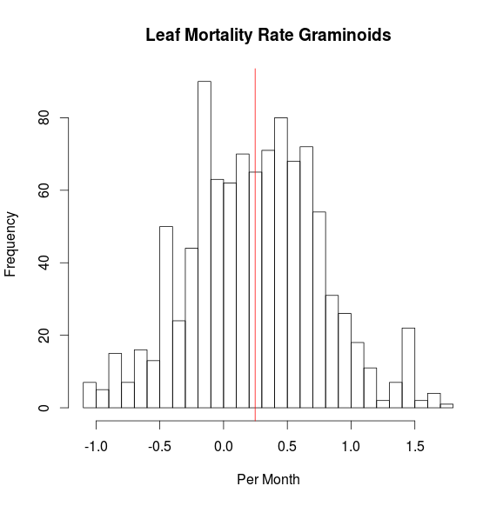
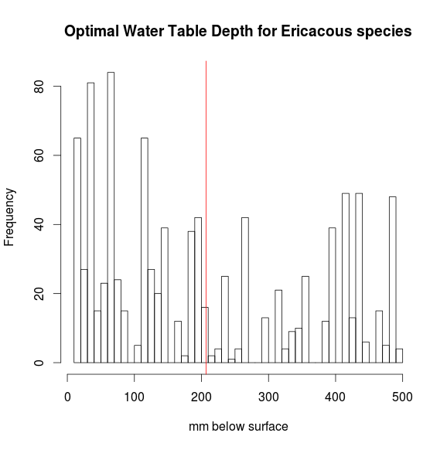
Posterior distributions
Notes:
Prior range??

Slide 12
Future perspective
Is it possible to calibrate this model for individual sites, by changing some of the plant parameters?
  Yes, it is possible.
  If so, do the differences in parameters have an ecological meaning or can they be explained by other factors, such as climate?
  Based on the morris SA we know which parameters are sensitive,
    Growth and Mortality
How are sites in different climates different from each other?
  Work in progress
Notes:
These are the same as the questions asked by Profound.

Slide 13







Many thanks

Slide 14
Introduction
Why peatlands?
  Largest pool terrestrial soil carbon (Gorham 1991)
  Only 3% landsurface
  Sphagnum
    Pullens et al. 2015 (under review) Carbon fluxes of an alpine peatland in Northern Italy
    Site comparison
Gorham, E. 1991. Northern Peatlands : Role in the Carbon Cycle and Probable Responses to Climatic Warming. Ecological Applications 1:182–195.

Slide 15
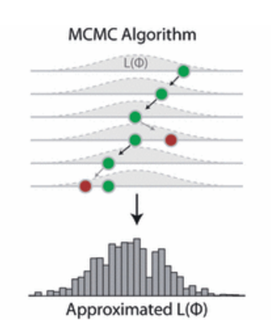
Future perspectives
MCMC – Markov Chain Monte Carlo
DREAM¹
Picture from: Hartig, F., J. M. Calabrese, B. Reineking, T. Wiegand, and A. Huth. 2011. Statistical inference for stochastic simulation models - theory and application. Ecology Letters 14:816–827.
¹ Vrugt, J. A., C. J. F. ter Braak, C. G. H. Diks, B. A. Robinson, J. M. Hyman, and D. Higdon. 2009. Accelerating Markov chain Monte Carlo simulation by differential evolution with self-adaptive randomized subspace sampling. International Journal of Nonlinear Sciences and Numerical Simulation 10:273–290.
Notes:
DiffeRential Evolution Adaptive Metropolis (DREAM)

